Slide 1
Lecture 10 – Finite State Machines & State-Dependend Dynamic Interaction Modeling
COMP 3700: Modeling and Design
Chapter 10: Finite State Machines
Chapter 11: State-Dependent Dynamic Interaction Modeling
Gomaa, 2011

Slide 2
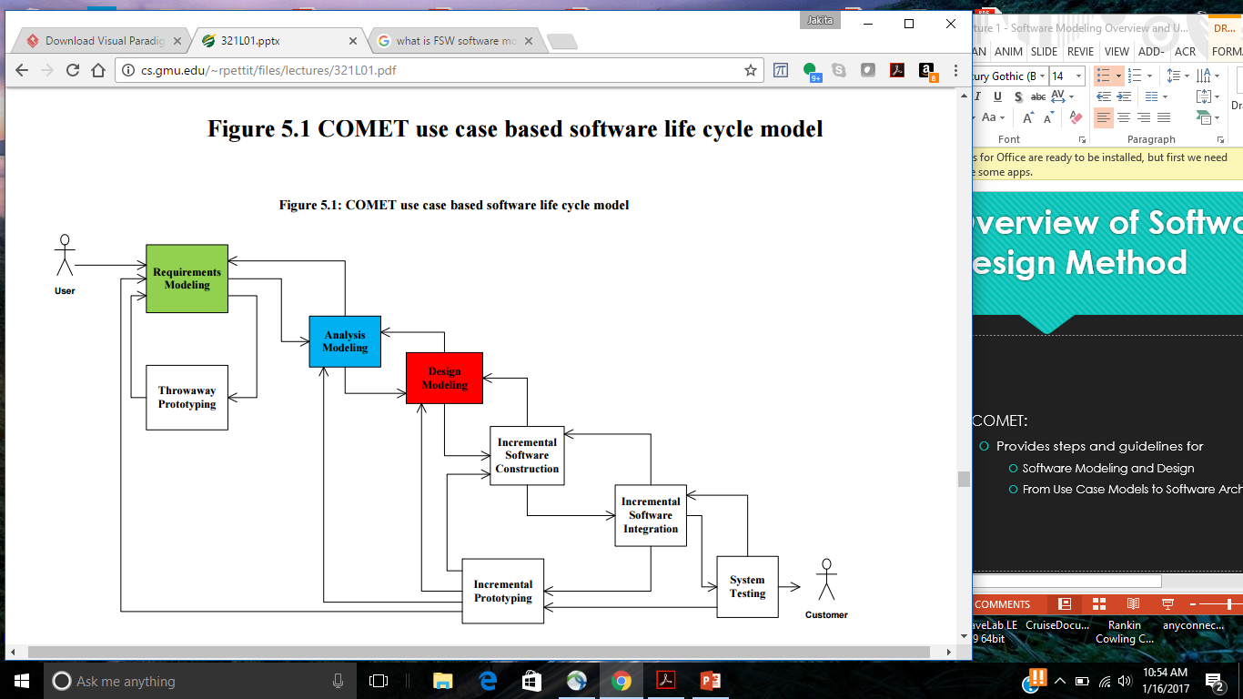
COMET Use Case Based Software Life Cycle Model
Develop Software Requirements Model
Develop Use Case Model (Chapter 6)
Develop Software Analysis Model
Develop Static model of problem domain (Chapter 7)*
Structure system into objects (Chapter 8)
Develop statecharts for state dependent objects (Chapter 10)
Develop object interaction diagrams for each use case (Chapter 9, 11)

Slide 3
Steps for Dynamic Modeling
Determine how objects interact with each other to support use case (called object interaction modeling)
Start with external event from actor (i.e., main path through use case description (scenario))
Determine objects needed to support use case scenario (using object structuring criteria – Chapter 8)
Depict the system external classes and boundary classes (Chapter 8)
Determine sequence of messages between the steps in the use case scenario
Depict on communication diagram or sequence diagram (also called interaction diagram)
Repeat steps 1 – 4 for each alternate path (articulated in the use case description)

Slide 4
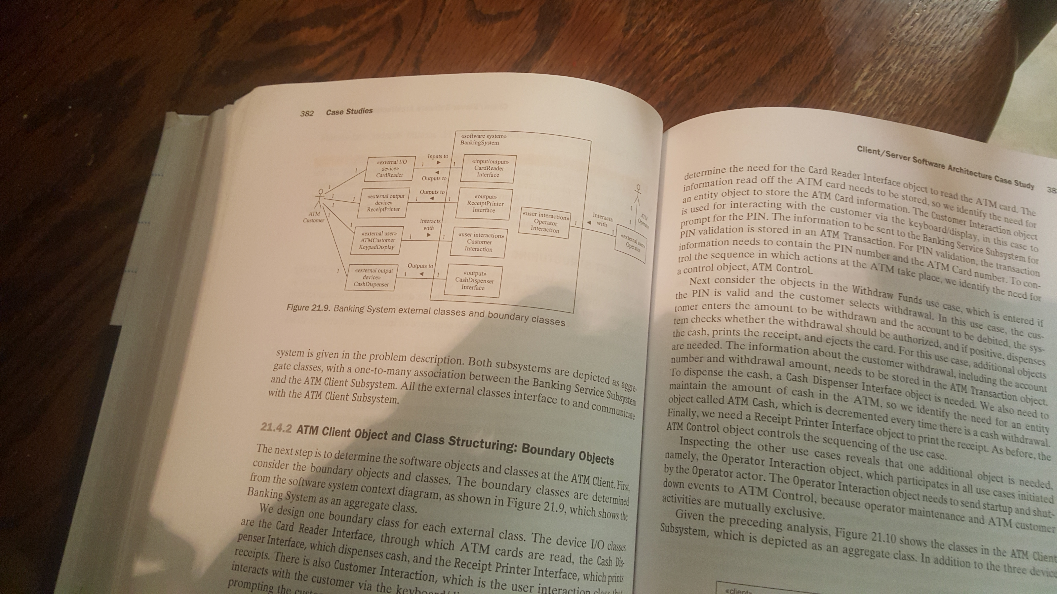
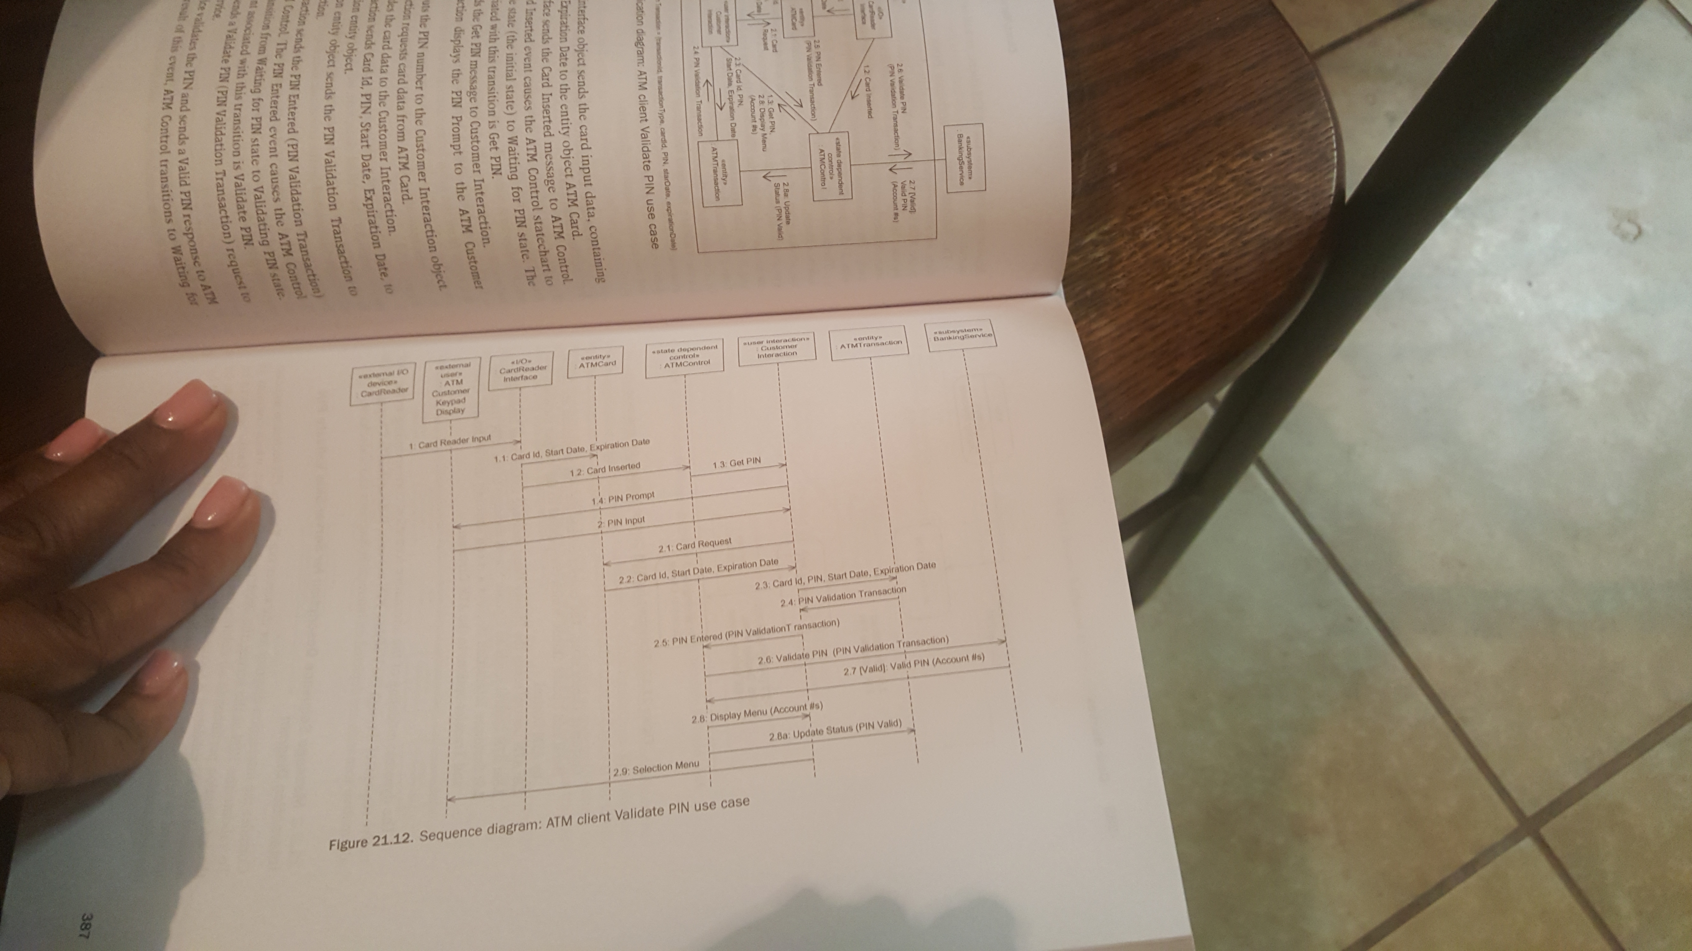
Depict sequence of messages on interaction diagram
Communication or sequence

Slide 5
Participation Activity 8: Peer Review of Interaction Diagrams
Please come prepared on Tuesday to peer review each other’s interaction diagrams
You’ll need to have available/bring/print
Use case scenario
Interaction diagrams for that use case scenario
Upload updated interaction diagrams for chosen use case scenario

Slide 6
COMET Use Case Based Software Life Cycle Model
Develop Software Requirements Model
Develop Use Case Model (Chapter 6)
Develop Software Analysis Model
Develop Static model of problem domain (Chapter 7)*
Structure system into objects (Chapter 8)
Develop statecharts for state dependent objects (Chapter 10)
Develop object interaction diagrams for each use case (Chapter 9, 11)

Slide 7
Finite State Machines and Statecharts
Many information and real-time systems are state dependent
Action depends not only on input event
Also depends on state of system
Finite State Machine
Finite number of states
Only in one state at a time
Statechart
Graphical representation of finite state machine
States are rounded boxes
Transitions are arcs
Statechart relates events and states

Slide 8
States and Events
State
A recognizable situation
Exists over an interval of time
Represents an interval between successive events
Event
A discrete signal that happens at a point in time
Also known as a stimulus
Has no duration
Causes change of state
Referred to as state transition

Slide 9
Events and Conditions
State transition label
Event [Condition]
Condition is a Boolean function
Conditions are optional on statecharts
Condition is true for finite period of time
When event occurs, condition must be true for state transition to occur
If condition is false, state transition does not occur

Slide 10
Actions
State transition label
Event / action(s)
Event[condition] / action(s)
Action
Executed as a result of state transition
Executes instantaneously at state transition
Terminates itself
Is optional

Slide 11
Entry and Exit Actions
Entry action
Action executed on entry into state
Entry / action
Ex: Start Cooking
Exit action
Action executed on exit from state
Exit / action
Ex: Stop Cooking

Slide 12
Hierarchical Statecharts
Disadvantages of State Transition Diagrams and Flat Statecharts
Complex State Transition Diagrams get very cluttered
Limited capability for managing complexity
Hierarchical Statecharts
Based on Harel Statecharts
Notation for hierarchical decomposition of state transition diagrams
Composite state decomposed into substates
Default entry states
Transition out of composite state corresponds to transition out of every substate

Slide 13
Hierarchical Statecharts

Slide 14
Hierarchical Statecharts
Sequential decomposition
When object is in composite state
It is in one and only one of substates
Transition into composite state
Must be to one and only one of substates
Aggregation of state transitions
If same event causes transition out of every substate
Then aggregate into transition out of composite state

Slide 15
Guidelines on Statecharts
State name must be passive not active
Represents time period when something
Is happening
Ex: Waiting for PIN
Identifiable situation
Ex: Idle, Initial
State names must be unique
Must be able to exit from every state
Flat statechart
Statechart is only in one state at a time
Hierarchical statechart
Sequential decomposition
Statechart is only in one substate at a timec

Slide 16
Guidelines on Statecharts
Event is the cause of the state transition
Event happens at a moment in time
Event name indicates something has just happened
Ex: Card Inserted, Door Closed
Action is the result of the state transition
Action is a command
Ex: Dispense Cash, Start Cooking
Action executes instantaneously
Activity executes throughout a given state
More than one action possible with a state transition
No sequential dependency between actions

Slide 17
Guidelines on Statecharts
Condition is a Boolean value
Event [Condition]
State transition only occurs if
Event happens & Condition is True
Condition is True over some interval of time
Actions, Activities and Conditions are optional

Slide 18
Developing Statechart from Use Case
Repeat steps 1 – 5 for each use case
Combine charts for entire use case model
Develop hierarchical statechart
States that can be aggregated to form composite state
Event causing transition from several states
Create composite state with one transition out of composite state instead of many transitions of substates
Develop state dependent use case
Start with scenario (one path through use case)
Consider sequence of interactions between actor and system
Consider sequence of external events
Input event from external environment
Causes state transition to new state
Action may result form state transition
Initially develop flat statechart
Consider alternative external events
Could result in additional states
Could result in additional state transitions

Slide 19
Developing Statechart from Use Case: Withdraw Funds
Steps 1 - 4

Slide 20
Developing Statechart from Use Case: Withdraw Funds
Steps 5 - 7

Slide 21
Developing Statechart from Use Case: Withdraw Funds
Step 8

Slide 22
Developing Statechart from Use Case: Withdraw Funds

Slide 23
Developing Statechart from Use Case: Withdraw Funds

Slide 24
Participation Activity 9 & Preparation Activity 10: State Charts
Remaining in in-class groups, use the same use case scenario from Participation Activities 7 and 8
Follow the five steps to create a flat state chart for that use case
Upload into Canvas
the flat state chart for that use case
Updated interaction diagram for that use case
Please come prepared on Thursday to peer review each other’s state charts- you’ll need to have available/bring/print:
Use case scenario
State chart for that use case scenario
Updated interaction diagram for that use case

